Slide 1
Natural Language Processing (NLP) Lab

Slide 2
Spam Detection

Slide 3
Example 1:
Spam dataset is a collection of 425 SMS spam messages was manually extracted from the Grumbletext Web site. This is a UK forum in which cell phone users make public claims about SMS spam messages, most of them without reporting the very spam message received. The identification of the text of spam messages in the claims is a very hard and time-consuming task, and it involved carefully scanning hundreds of web pages.
Source: https://archive.ics.uci.edu/dataset/228/sms+spam+collection

Slide 4
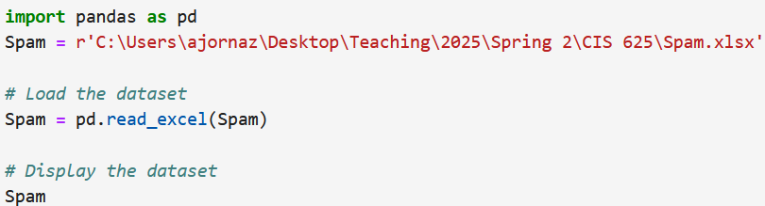
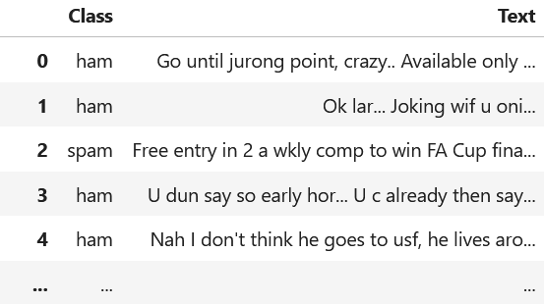
Import the dataset, and print out.

Slide 5
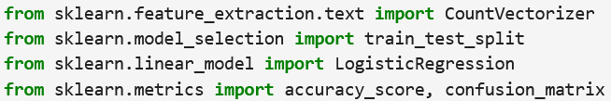
Import the required modules and libraries.
Note: You may need install scikit-learn library.

Slide 6
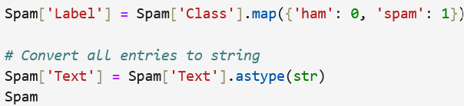
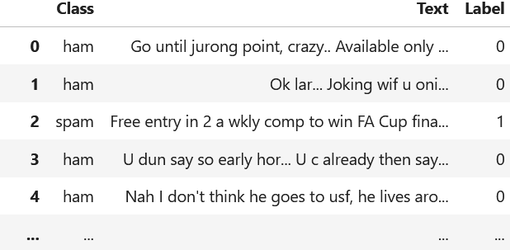
Create a new column to encode the type of email as (0 – ham) and (1 – spam).

Slide 7
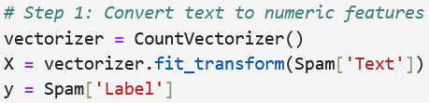
Convert text data into a numeric format (transforms the text into a sparse matrix of token counts). Then split the dataset.

Slide 8

Fit logistic regression model.

Slide 9
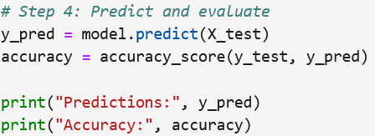

Find the precited values and calculate the model accuracy.

Slide 10

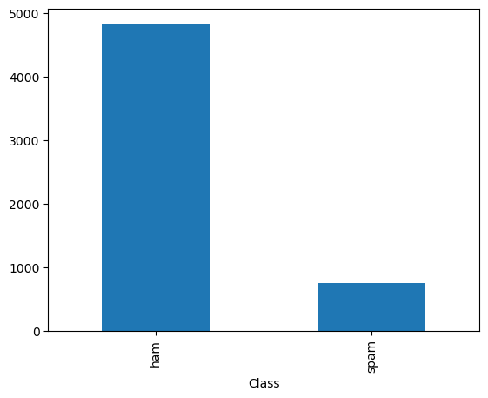
Plot a bar chart for the Class (message's type).

Slide 11
Predicting Binary Response

Slide 12
Example 2:
In lab 4, we covered an example to predicted acceptance (accept/denied) of undergraduate applicants in hopes of realizing their dreams to become physicians. The predictors are GPA, MCAT (MCAT subscore), Apps (Number of medical schools applied to), and Sex

Slide 13
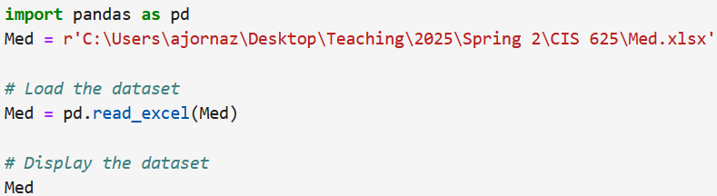
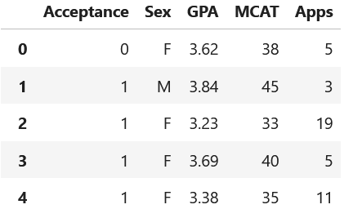
Import the dataset, and print out.

Slide 14
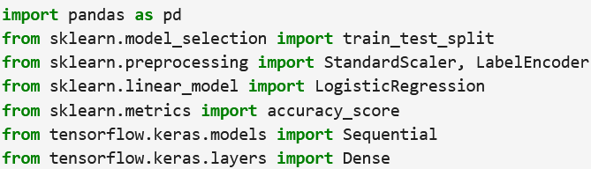
Import the required modules and libraries.

Slide 15
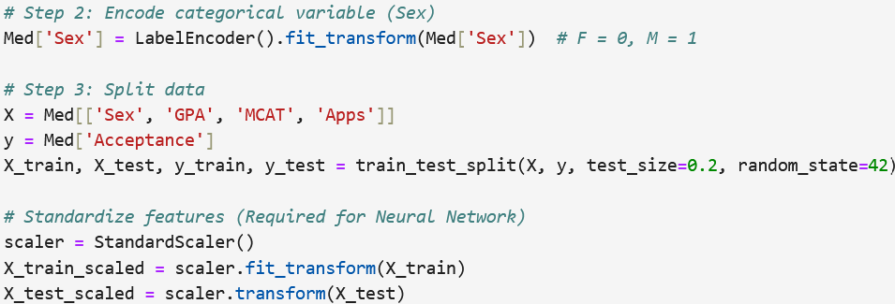
Convert the categorical variable “Sex” into dummy/indicator variable (0, 1), then split and scale the dataset .
Neural networks require scaling (or normalizing) the dataset.

Slide 16
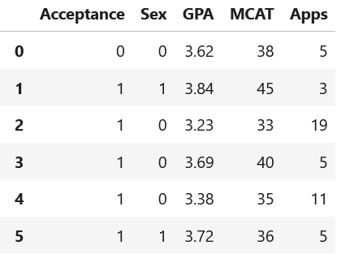
Table 1 The Med dataset after Encoding “Sex”

Slide 17

Fit a multiple logistic regression model to predict the acceptance.

Slide 18
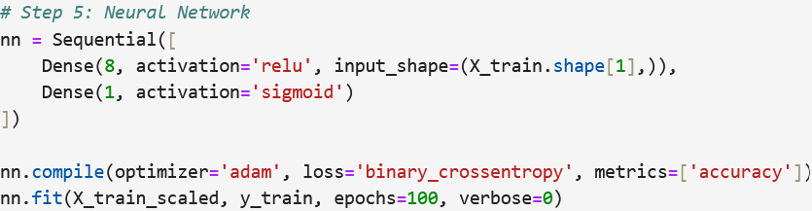
Fit a neural network model to predict the acceptance.
We set one hidden layer with 8 neurons.
There is one output neuron based on the sigmoid function.
We can add more hidden layers and neurons, but that would make the model more complex and could lead to overfitting.

Slide 19
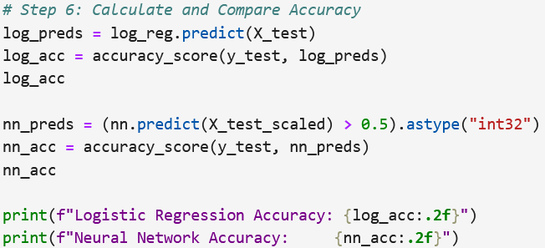
Evaluate the performance using confusion matrix. Calculate the models accuracy metrics.

Slide 20

The basic neural network model predicted the outcome of acceptance with accuracy = 73%.
When we re-run the code, we may get different results due to the randomly selection of the training and test subset.
Increasing the number of hidden layers and neurons can help improve the model’s accuracy.

